Slide 1

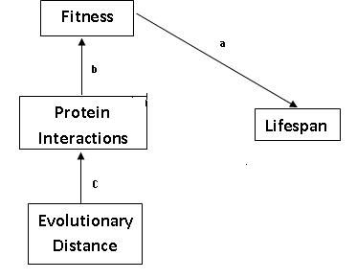
Effect of Protein Network Robustness on Cellular Aging Charita Montgomery, Whitney Payton and Dr. Hong Qin
Biology Department, Spelman College, Atlanta, GA 30314
Spelman College
INTRODUCTION:
Cellular aging has been a highly biologically debated topic for decades. It has been suggested that the evolution of prokaryotes and eukaryotes is the cause for the initiation of aging in asymmetric dividing cells (Qin, 2010). Earlier research studies have shown that the yeast Saccharomyces cerevisiae is the best model to use when testing cellular aging. Yeast aging can be measured in two ways: replicative life span (RLS) and chronological life span (CLS)(Qin, 2010). Previous research conducted by Dr. Hong Qin has provided the evidence that phenotypic capacitors influence network robustness suggesting that protein network robustness is a contributing factor for cellular aging. Robustness is the ability of a cell to maintain homeostasis throughout environmental changes and mutations, such as temperature, time, and cellular damage. In this study the relationship between RLS and robustness of the protein networks in the yeast S. cerevisiae were examined.
HYPOTHESIS:
We hypothesized that the robustness of the protein networks will be directly proportional to the RLS of S. cerevisiae.
RESULTS:
DISCUSSION:
ACKNOWLEDGEMENTS
This research was supported by NIH.
Figure 1: The Alternative Hypothesis Model
Figure 2: Distribution of P Values for Q Value test
Distribution of the P-Values for S. Cerevisiae mutants’ to Replicative Lifespan
Figure 3: Relationship of RLS to Protein Robustness
1. Fitness is directly related to Lifespan (p<0.01).
2. Most of the mutants had p values between 0.0 and 0.1. Only two mutants, C125 and D203 , had false positive p values from the 5% test.
3. Robustness is ____ related to lifespan.
METHODS:
Experimental Design: Computational biology was used. We performed a linear regression test to compare the protein robust factors to cellular aging. These results were each plotted for further analysis. A multiple regression test was done to find the dependency between the 3 protein robust factors and cellular aging. A separate linear regression test was conducted to obtain the p values for the 502 S. Cerevisiae mutants. The Q values for these results were calculated to determine which mutants were false positive. A linear regression of the standard deviations for each mutant to lifespan was performed to determine robustness. All of the regression test and plots were conducted using the computer program R 2.10.1. The p values and R squared value’s from each regression test were analyzed to determine the relationships.
REFERENCES:
Qin, H. 2010. RUI: Testing the network hypothesis of cellular aging in Saccharomyces cerevisiae. 1-20.
Fraser, H.B., A.E., Hirsh, L.M. Steinmetz, C. Scharfe and M.W., Feldman.2002. Science Magazine, 296:750-752.

Slide 2
Shorten abstract, emphasize conclusions and main findings.

